Slide 1
Gender factor Study in top US universities’ admission?
Xin Tang

Slide 2
Agenda
Introduction
Overview of the topic
Analysis & Findings
Ethical concerns
Reference

Slide 3
Introduction

Slide 4
In lieu of rfair admission lawsuit against Harvard University's undergraduate admissions process, which is claimed to discriminate against Asian American applicants, there is another concern that genders also play a role in top US universities’ admission.
This study is intended to validate if this is a fact that female students have more chance to get admitted. Study will draw a conclusion based on data from top universities, including public data published from interested universities and other open resources.

Slide 5
Overview of the topic

Slide 6
local picture: Westwood high school #79 in National STEM high schools #1 in Round Rock ISD
Big Picture:
Top University class 2026
Freshman Undergraduate Gender ratio
Class 2022 Top 10 student data:
Male: Female: 6:4
Female always at majority: median @51.2%
Rank | Gender | School | Track
1 | F | UT Austin | STEM Honor program
2 | M | UT Austin | STEM Honor program
3 | F | UT Austin | STEM
4 | F | UT Austin | STEM
5 | M | MIT | STEM
6 | M | Georgia tech | STEM
7 | M | UT Austin | STEM Honor program
8 | M | UT Austin | STEM
9 | F | UT Austin | STEM & Business
10 | M | UT Austin | STEM Honor program
Ivy League | School name | Class 2026 male | Class 2026 female
Y | Harvard | 45.8% | 54.2%
Y | Yale | 49.0% | 51.0%
Y | Princeton | 49.0% | 51.0%
Y | Dartmouth | 49.5% | 50.5%
Y | Columbia | 49.1% | 50.9%
Y | Cornell | 45.1% | 54.9%
Y | Brown | 48.8% | 51.2%
Y | U penn | 44.0% | 56.0%
No | Duke | 45.7% | 54.3%
No | MIT | 48% | 52%
No | Stanford | 49.0% | 51.0%
No | RICE | 50.0% | 50.0%
No | UT Austin | 40.7% | 59.3%
Among top high school students, male are majority, However there are always more females first year undergraduate in top universities.
Is there a gender-based preference?

Slide 7
Analysis and Findings

Slide 8
Questions to be answered:
Is this a commonly concerned topic (aka: frequently searched)?
Overall Is there are significantly more female high school students than male students?
Are there significantly more male applicants than female applicants to top universities?
If data available, how’s the data from top schools says?
How’s data from other resources, like media say?

Slide 9
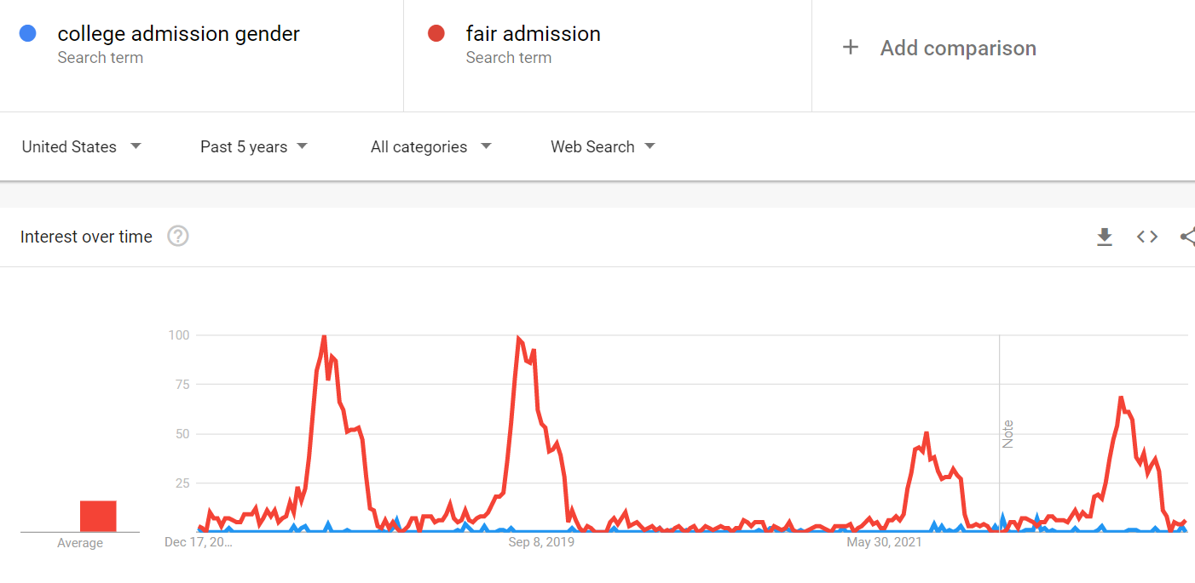
Google trend: gender bias is not a commonly interested topic, at least comparing to race concern.

Slide 10
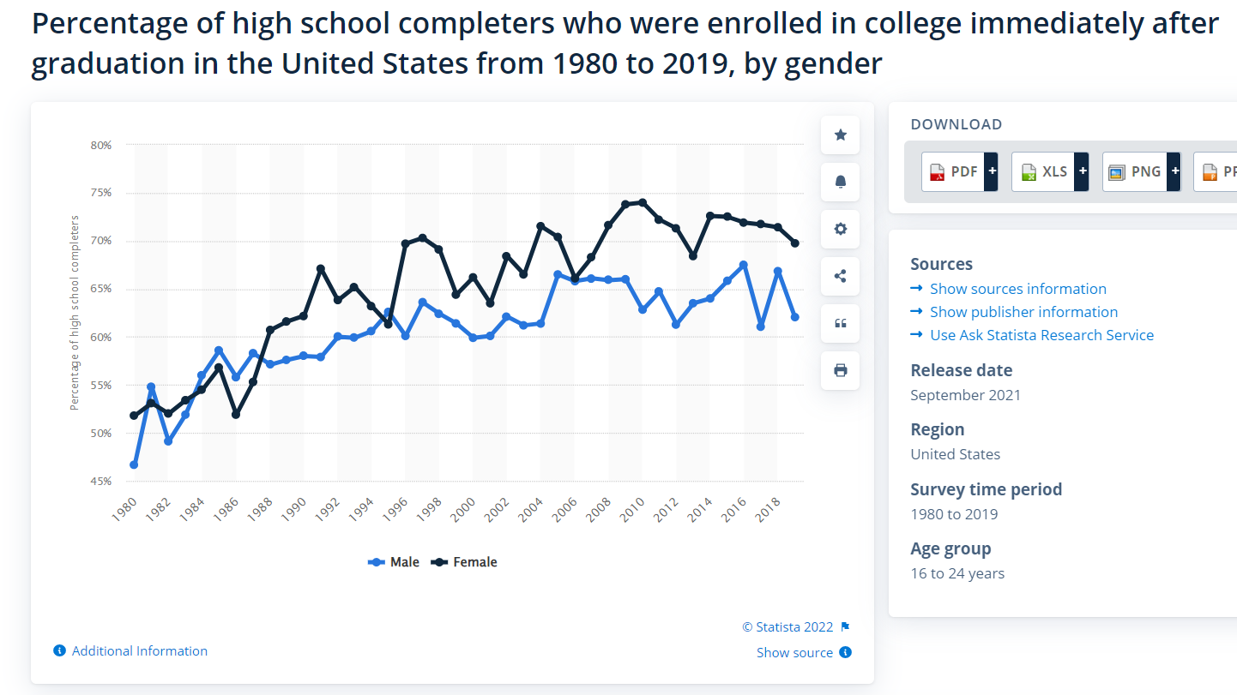
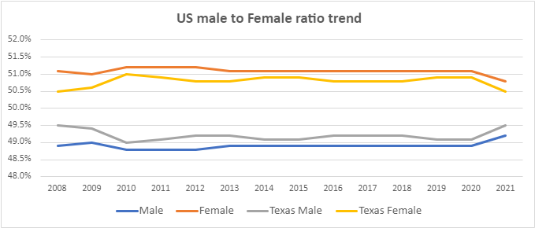
There are more female students in US and more female applicants for colleges/universities.
Always more females
assume this will translate into similar male/female student ratio in high schools
Always more females enroll into colleges
This include all colleges, including community colleges, consider the numbers of colleges in US, score/performance may not be a factor to enrolled into a college.

Slide 11
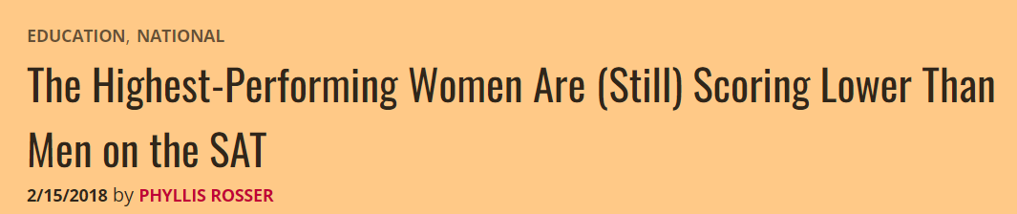
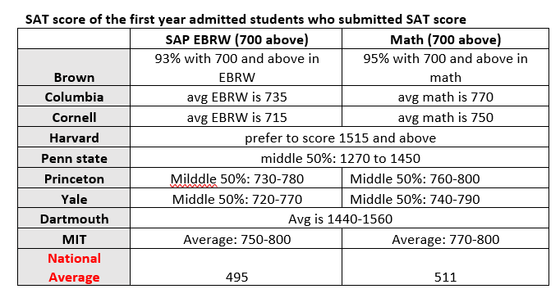
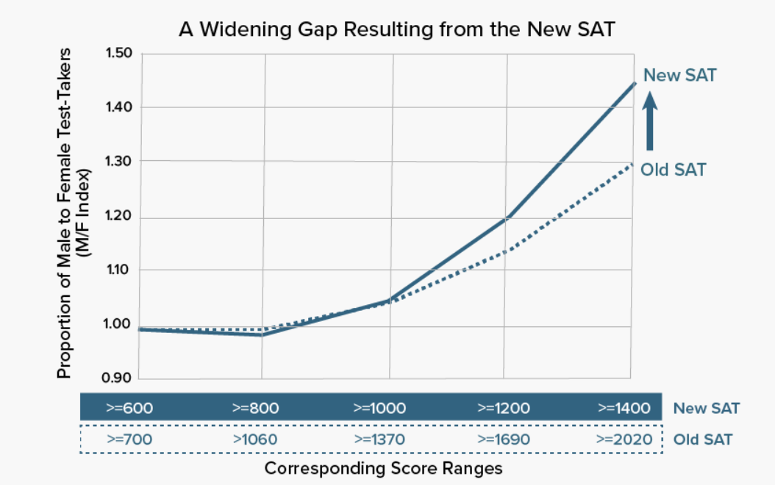
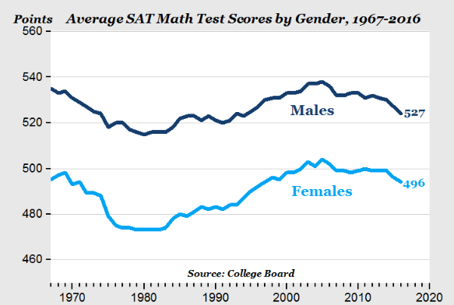
There is no much data to show male/female applicants for top universities. So, I searched from a different angle: SAT score.
Data showed that he top universities almost required perfect SAT score. Meanwhile, the data showed the male is 1.4-1.5 time more likely to achieve SAT at that level. The highest performing woman still score lower than men.
From this angle, more men will be qualified to be admitted into top colleges.

Slide 12
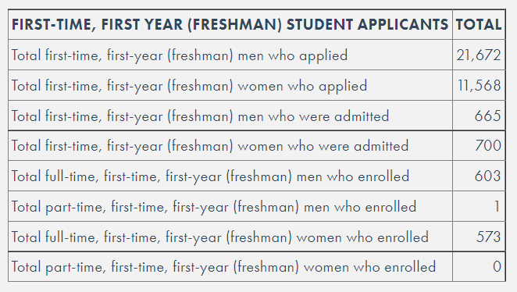
Case Study: MIT: a pure STEM top university require a perfect score to get in
it is twice likely for a female applicant get admitted into MIT than male
Class 2021 data
Findings:
Male/Female applicant ratio: 1.87 : 1
Male admission rate: 3% vs Female admission rate: 6%

Slide 13
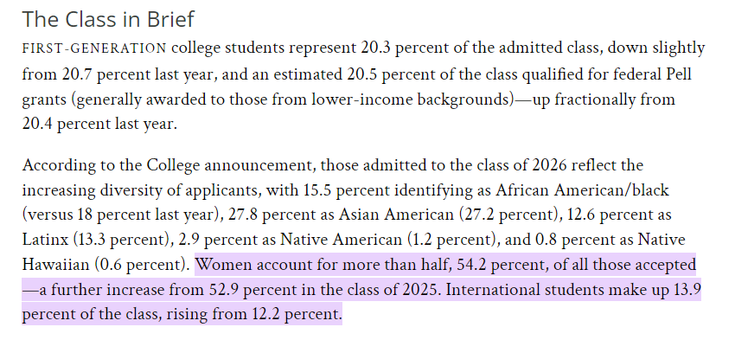
Case Study: Harvard: a well-known top university also require perfect SAT score
Washington post reported more female get admitted and still increasing

Slide 14
Case Study: Harvard: a well-known top university also require perfect SAT score
Washington post reported more female get admitted and still increasing

Slide 15
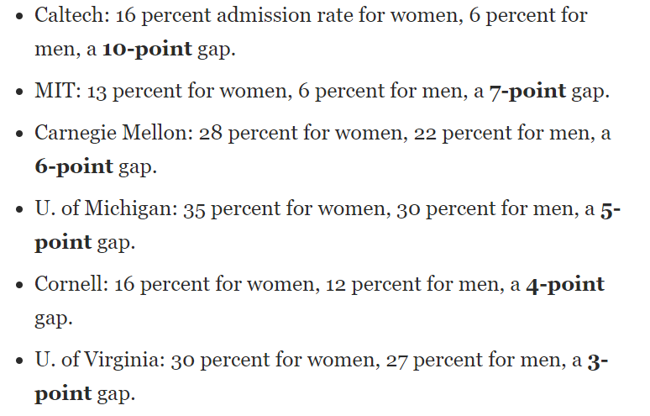
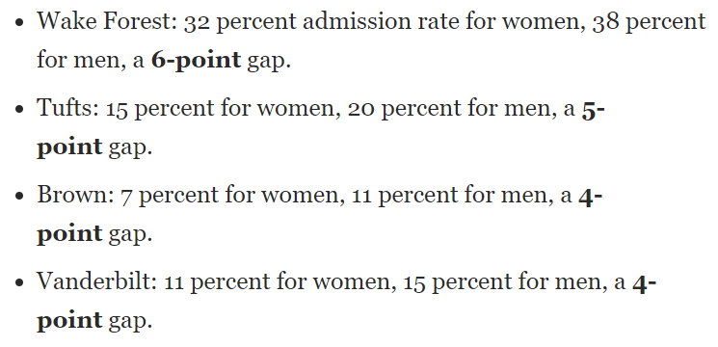
What US News and The Washington Post say on this:
Quotes from US News:
Among the 478 ranked national undergraduate institutions which accept both men and women and reported admissions data to U.S. News, the average discrepancy between the male and female acceptance rate was a 2.6 percent advantage for female applicants.
Quotes from The Washington Post:
Of the Top 30 US news national universities, 10 had gender differences of 3 or more percentage points in admission rate.
Universities with gaps that favored women
Universities with gaps that favored men

Slide 16
Conclusions
After looking at population ratio, the general and the top school's student gender ratio, admission data from top universities and media coverages on this topic, my conclusions are:
It is a fact that there are more female students than male, generally and in top universities.
It is also true that some top ranked universities, like MIT and Harvard, have significant better admission rate for female applicants than male.
The gender gap could also be one way or another and not at the same level among universities.
Not all universities released detail data on gender.
It is better for students to investigate their dream schools for more details before applying.

Slide 17
Ethical concerns

Slide 18
Ethical Concerns
Without an agreed baseline, it is difficult to define what is being considered as equal or bias on gender factors.
It is sensitive for school to release related data for public analysis or scrutinize.
How will gender gap change the behavior of students/parents?

Slide 19
Reference

Slide 20
References
Not all references were listed here due to space
Fair admission vs college admission gender search trend – Google trend.
https://trends.google.com/trends/explore?date=today%205-y&geo=US&q=college%20admission%20gender,fair%20admission
Common data sheet, diversity dashboard and first year admission statistics - MIT
https://ir.mit.edu/cds-2022
https://mitadmissions.org/apply/process/stats/
https://ir.mit.edu/diversity-dashboard
How gender influence college admission -US News
https://www.usnews.com/education/best-colleges/articles/2018-11-02/how-gender-influences-college-admissions#:~:text=Among%20the%20478%20ranked%20national,percent%20advantage%20for%20female%20applicants
Male/female ratio on top SAT score
https://msmagazine.com/2018/02/15/highest-performing-women-still-scoring-lower-men-sat/

Slide 21
Thank you

